Slide 1



Predictive Maintenance for Wind Turbine Failure
This presentation outlines a data-driven approach to optimize wind turbine reliability and minimize unplanned failures of wind turbine engines.

Slide 2

Project Leadership
Sharat Manikonda
Director at Innodatatics and Sponsor
linkedin.com/in/sharat-chandra

Slide 3
Contents
Business objective
Business Constraints
Project Architecture
Data collection and details
Exploratory Data Analysis
Visualization
Notes:
Change

Slide 4



Business Problem
Unplanned failures of wind turbine engines are causing significant losses and disruptions in electricity generation.
Business Objective
Unplanned failures of wind turbine engines are causing significant losses and disruptions in electricity generation.
Business Constraint
Maximize power generation during the process of reducing failures.

Slide 5
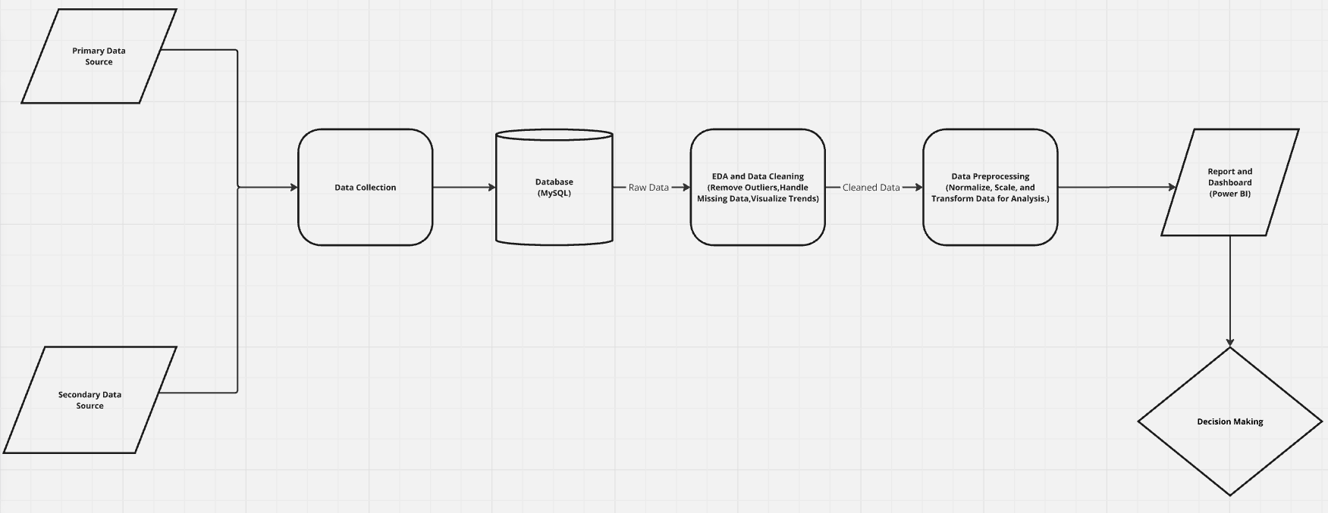
Project Architecture

Slide 6

Project Overview
Business Problem: Unplanned failures in wind turbine engines result in high operational costs, extended downtimes, and reduced power generation efficiency.
Objective: Use advanced data analytics to uncover patterns and insights from data, enabling early detection of turbine failure risks and data-driven maintenance strategies.
Approach:
Perform Exploratory Data Analysis (EDA) to identify trends, anomalies, and failure triggers.
Use statistical and visualization techniques to highlight correlations between variables such as rotor speed, temperatures, and failure events.
Develop an interactive dashboard for stakeholders to monitor performance and detect high-risk periods.
Expected Outcome:
Reduce turbine failure rates by at least 30%.
Enable proactive maintenance, minimizing unplanned downtime.
Save $2M annually by improving operational efficiency and lowering maintenance costs.

Slide 7


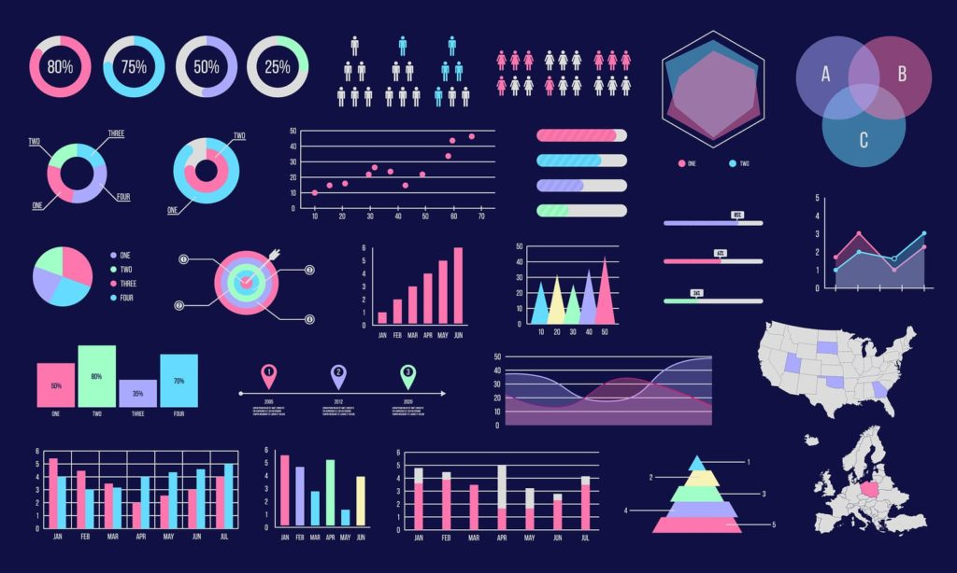
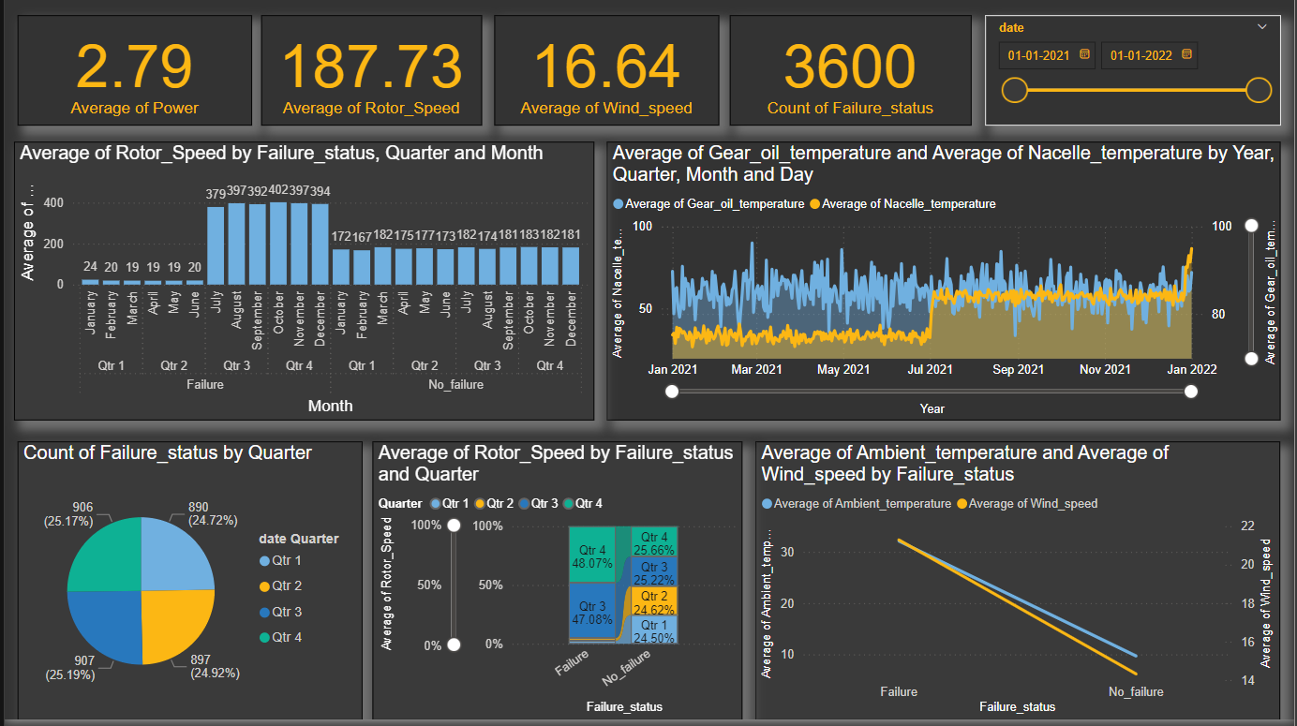

Project Scope
1. Handle missing values, outliers, and ensure data readiness for analysis.
2. Identify trends in turbine performance and failure patterns.
3. Develop interactive charts (e.g., heatmaps, line charts, bar charts) to communicate findings effectively.
4. Create a Power BI dashboard for real-time monitoring of turbine health and key metrics.
5. Summarize key findings and actionable recommendations for stakeholders.

Slide 8
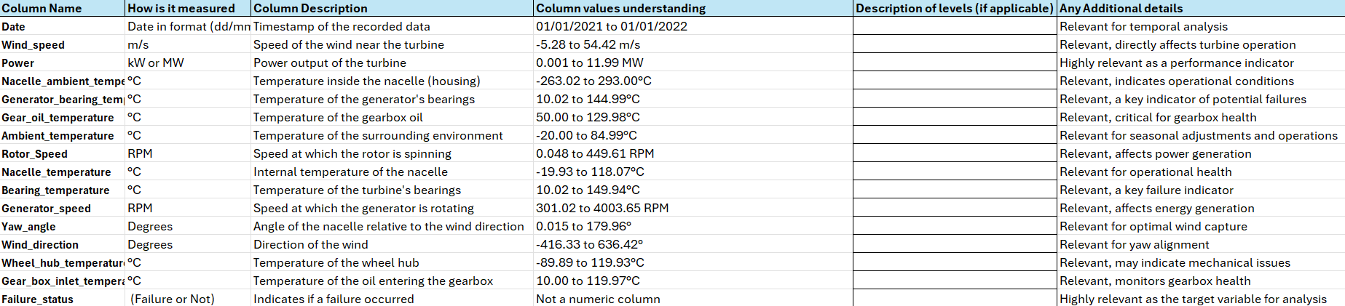
Data Dictionary

Slide 9

Exploratory Data Analysis [EDA]
Steps Performed:
1. Data Overview:
Checked dataset shape, column data types, and null values.
Summarized statistics for all numerical columns (e.g., mean, median, variance).
2. Visualization:
Histograms: Analyzed the distribution of numerical variables (e.g., Wind Speed, Power).
Boxplots: Identified outliers in each numerical column.
Correlation Matrix: Visualized relationships between variables (e.g., Rotor Speed and Power).
Count Plots: Displayed failure vs. no-failure distribution.
3. Time-Series Analysis:
Used lag plots to identify patterns over time.
Checked stationarity of numerical variables using the Augmented Dickey-Fuller (ADF) test.
4. Business Insights:
Correlation analysis showed which metrics impact failures (e.g., high temperatures or low rotor speeds).
Notes:
EDA is used for seeing what the data can tell us before the modeling task.
Change

Slide 10

Data Preprocessing
Steps Performed:
Handling Missing Values:
Imputed missing values in numerical columns using their mean.
Outlier Treatment:
Applied Winsorization (IQR method) to cap extreme values in numerical variables.
Duplicate Removal:
Checked and dropped duplicate rows to avoid redundant analysis.
Feature Engineering:
Created cleaned and winsorized data for further visualization in Power BI.
Scaling:
Standardized numerical columns (e.g., Wind Speed, Power, Rotor Speed) using StandardScaler to have zero mean and unit variance, ensuring consistent data ranges for clustering and visualization.
Exported Final Dataset:
Saved the processed dataset for loading into Power BI visualizations
Notes:
Keep observations

Slide 11
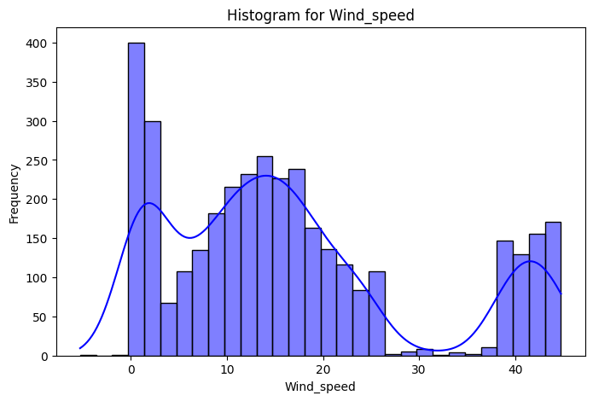
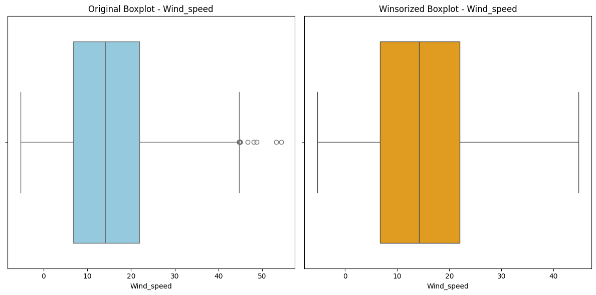
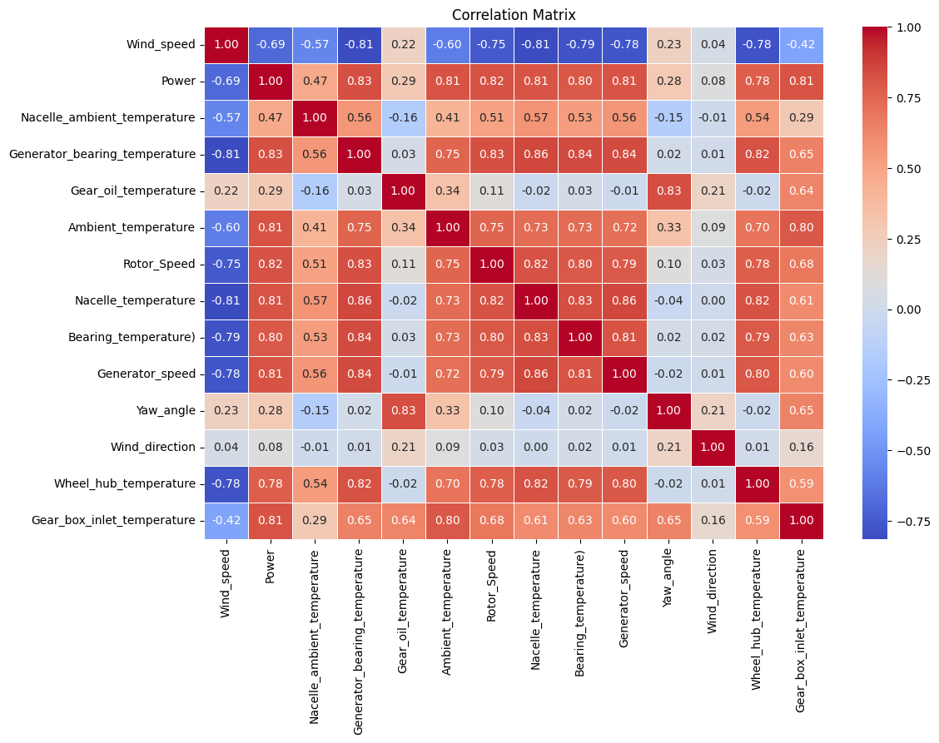
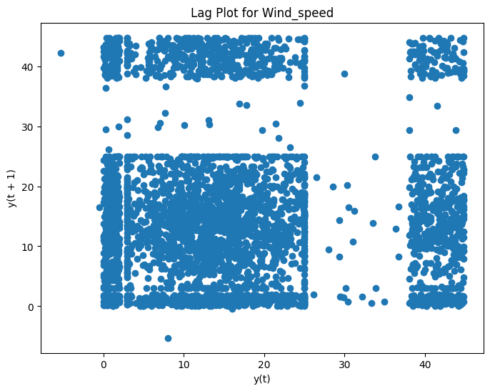
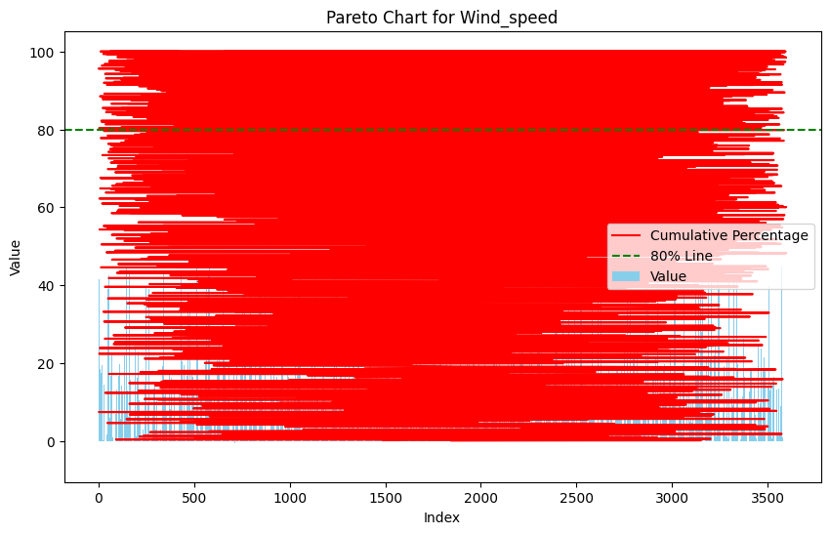
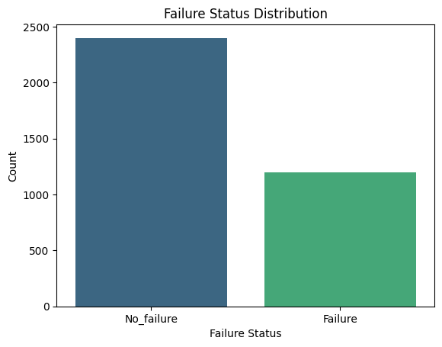
Data Visualizations
Notes:
Add graphical

Slide 12
Power BI - Dashboard

Slide 13


